Slide 1
Hierarchical Regression Analysis (Incremental Model Test)
Regression Analysis and Non-Linear Models: Sociology 6100

Slide 2
Incremental Model Test
Each model needs to be developed theoretically. (See example at the end)
Examine;
Change in Beta coefficients
Change in sign (positive or negative)
Change in significance level
Change in R²
E.g. DV: Sexual behavioral change

Slide 4
Computer-aided Significance Test
Y: perceptions toward certain groups
X₁: age, X₂: sex, X₃: education
Y: death rate due to heat
X₁: temperature, X₂: age of the residential area, X₃: volume of greens
Y: ACT score
X₁: Race, X₂: GPA in high school, X₃: SES
Forward addition
Start with the most significant IV
Y= a + bX₁
Y= a + bX₁ + bX₂
Y= a + bX₁ + bX₂+ bX₃

Slide 5
Computer-aided Significance Test (cont.)
Stepwise
Similar to forward addition. When IV becomes insignificant, it will be dropped from the equation.
Y= a + bX₁
Y= a + bX₁ + bX₂
Y= a + bX₂ + bX₃
X₁ became insignificant because of X₃
H₀: β₁=0 is not rejected
E.g. Y: ACT score
X₁: Race
X₂: GPA in high school
X₃: SES
Backward deletion
Start with all relevant variables, and least significant variables will be dropped first.

Slide 6
Theoretical Incremental Model Test
Full Model
Y = α + β₁X₁+ β₂X₂ … + β_{k}X_{k}
df= n – (k+1)
Reduced Model
Y = α + β₁X₁+ β₂X₂ … + βgXg
df= n – (g+1)
g < k

Slide 7
Theoretical Incremental Model Test (cont.)
Incremental Test for Full Model
H₀: β₁ = β₂ = … = β_{k} = 0
H_{a}: At least one of the β’s (h, i, j, k) is not 0
Δdf = [n-(g+1)] – [n-(k+1)] = k-g
# of parameters (variables) added
Conduct t-test for each additional β
For change in goodness-of-fit of each model, conduct F-test.
F-statistics is Reduction in Errors (SSE_{reduced model} – SSE_{full model}) is the result of additional parameters (h, i, j, k)

Slide 8
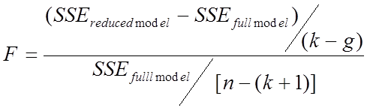
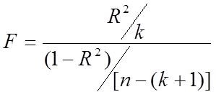
Theoretical Incremental Model Test (cont.)
Incremental Test for Full Model (cont.)
Df1 = k-g
Df2 = n-(k+1)
Goodness-of-fit for Regression Analysis
Df₁ = k
Df₂ = n-(k+1)

Slide 9
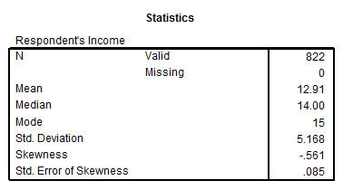
SPSS Outcomes and Tables
Income 13 is about $25,000

Slide 10
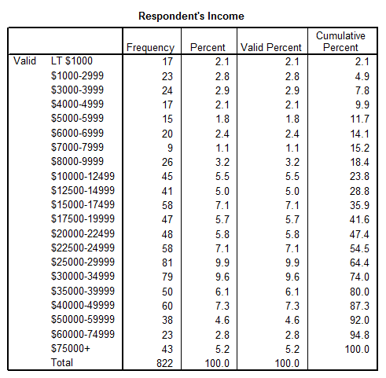
SPSS Frequency Table

Slide 11
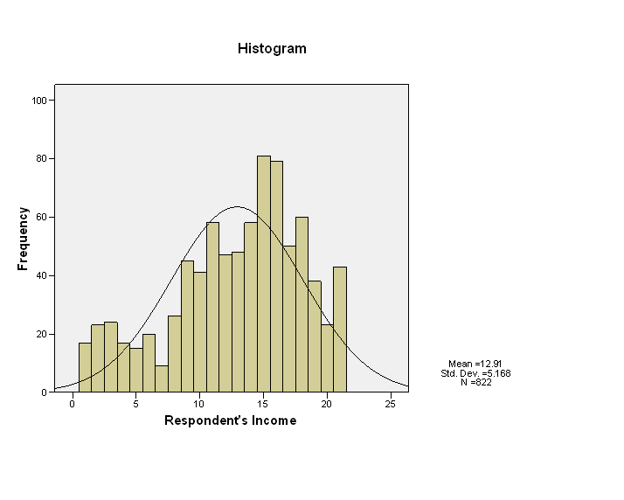
SPSS Histogram

Slide 12
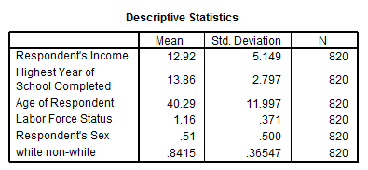
SPSS Regression Output and Statistics

Slide 13
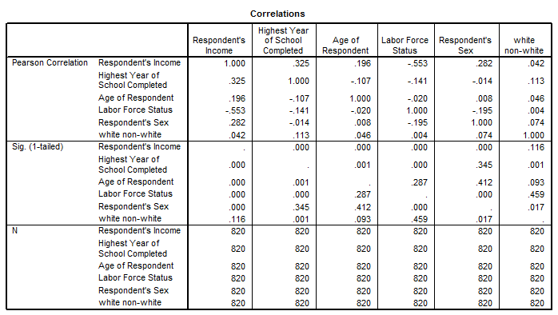
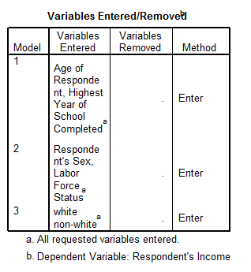
SPSS Regression Statistics (cont.)

Slide 14
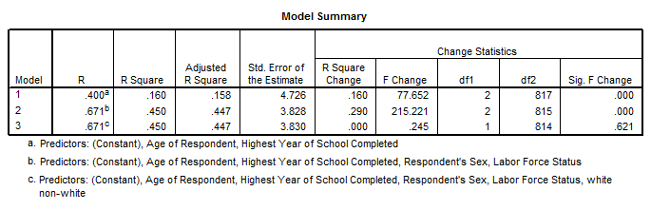
SPSS Regression Statistics (cont.)

Slide 15
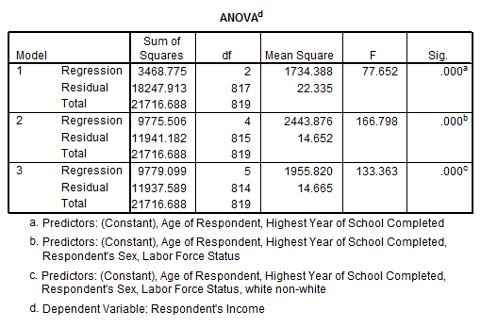
SPSS Regression Statistics (cont.)

Slide 16
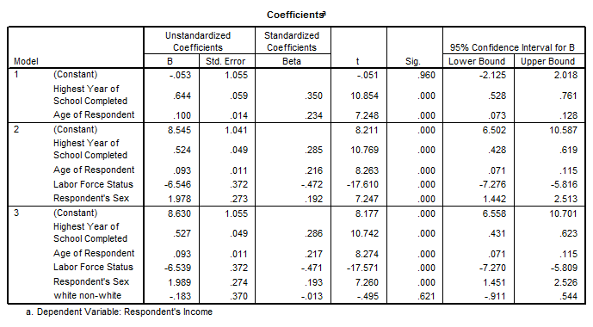
SPSS Regression Statistics (cont.)

Slide 17
Examples of Hierarchical Regression Analysis

Slide 20

Questions?

